Slide 1

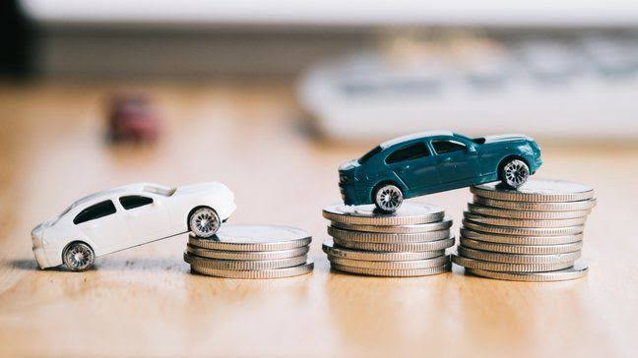
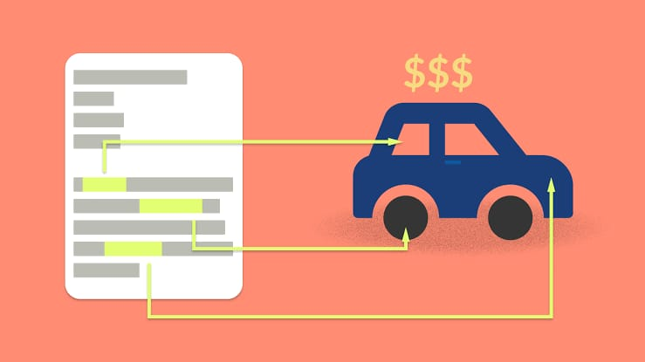
CAR PRICE PREDICTION S
Study Of Car Prices Post Covid-19 Impact

Slide 2
Problem statement
With the covid 19 impact in the market, we have seen lot of changes in the car market. Now some cars are in demand hence making them costly and some are not in demand hence cheaper. With the change in market due to covid 19 impact, the previous ML models are not performing well.

Slide 3
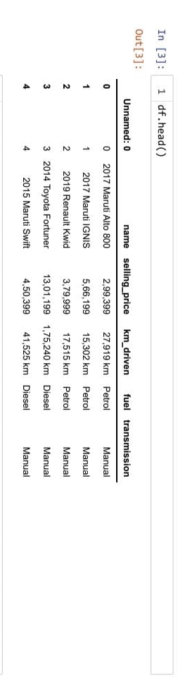
Extracting the car mode, and the cars manufacturer form the name.
Now name column is done its work and it can be dropped form the dataset.

Slide 4
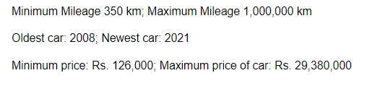
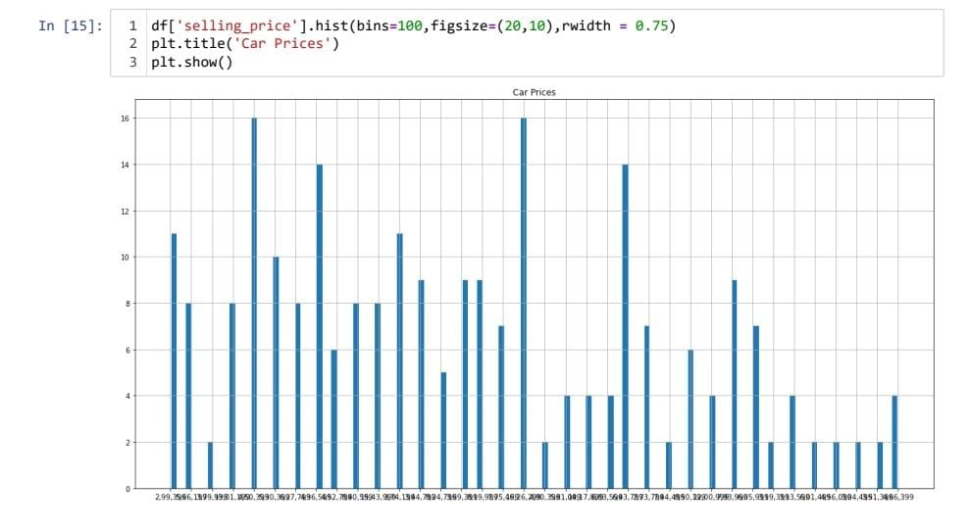
EDA
Lets dig deeper into the end points
Max mileage on this i20 car with a mileage of 1002408 and year 2010. the previous owner(s) drove a lot.

Slide 5
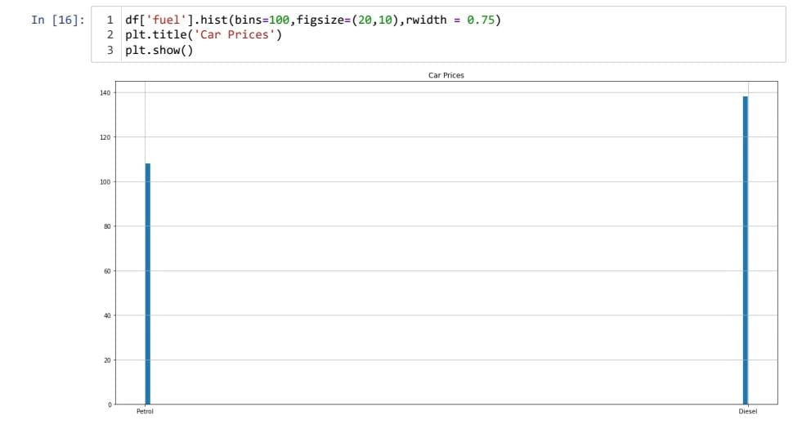
Car Prices According to Fuel

Slide 6
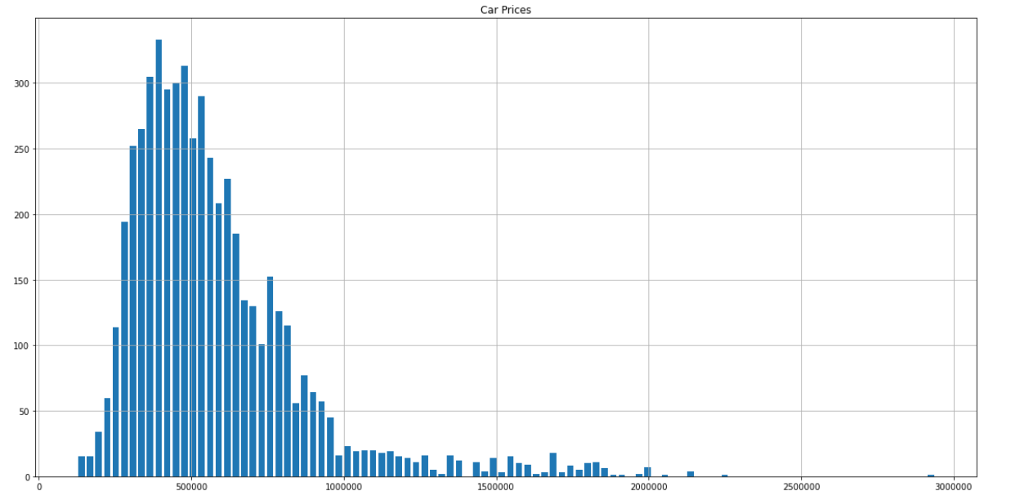
Car Prices Distribution
We can see we have quite some range on the prices of the cars.

Slide 7
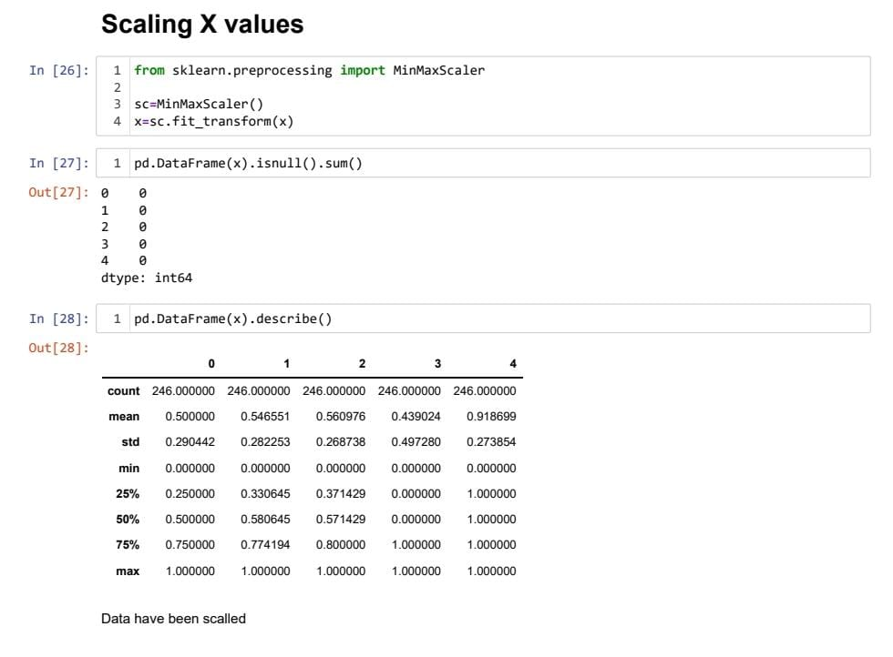
Data Pre-Processing

Slide 8
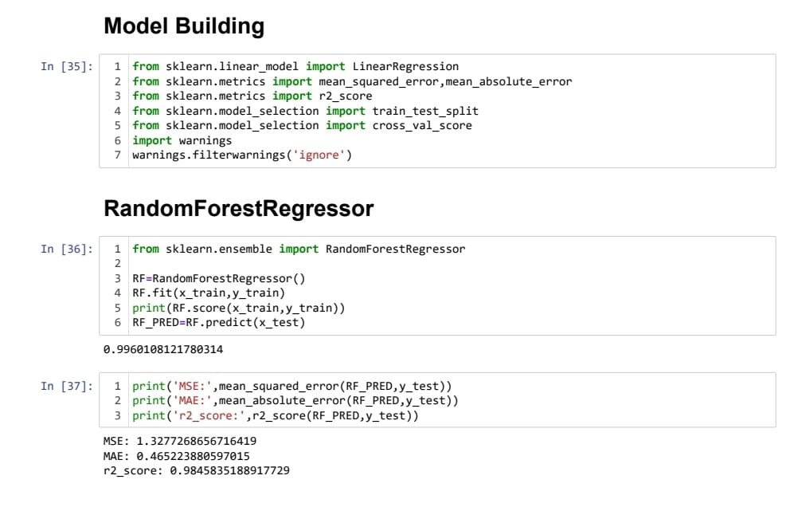
Model Building

Slide 9
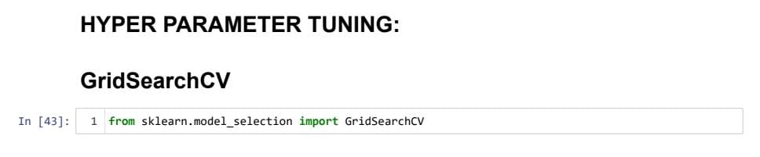
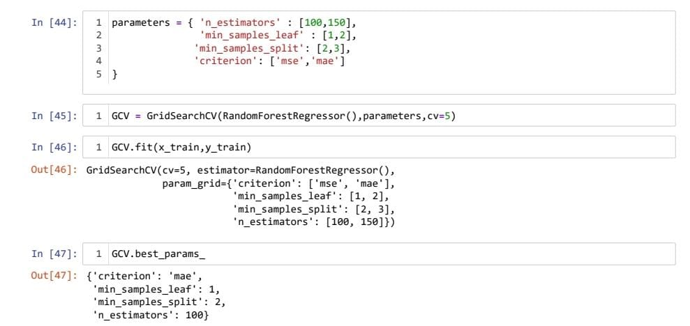
Hyper Parameter Tuning
Hyper parameter tuning was performed on the best performing algorithm, which was the random forest regression.
These variables were selected, the tuning took many hours to complete.
The best parameters were used to train another accurate model.

Slide 10
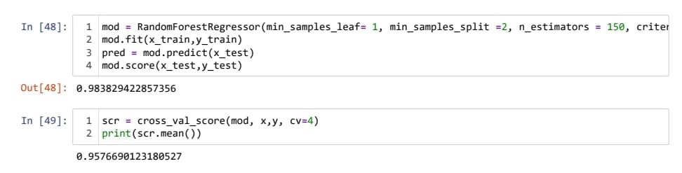
Training Best Model
This is the best model with a cross validation, R-squared result of 0.95766

Slide 11
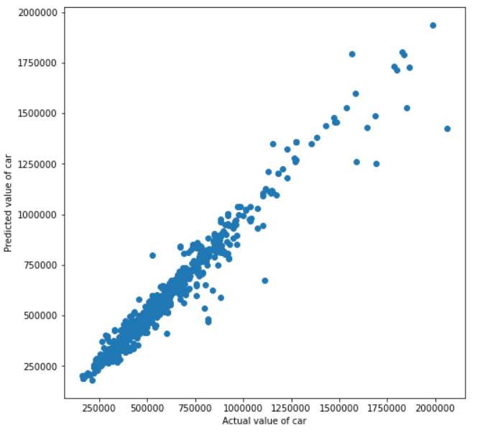
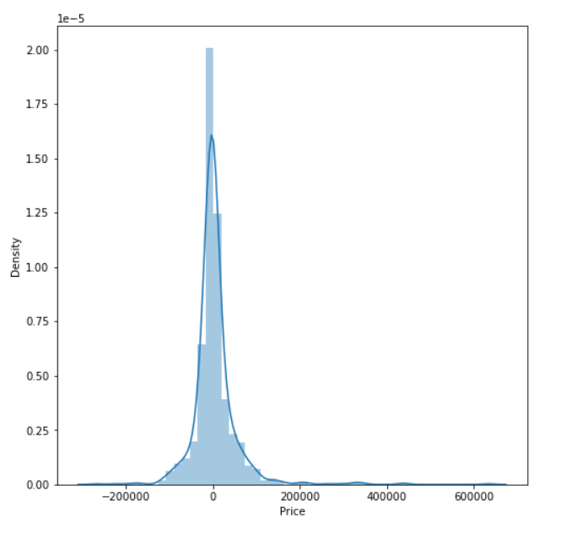
Scatter plot of predicted vs actual price
Distribution plot of (predicted value – actual value)
After observing these graphs we can conclude that the model is performing very well and it is ready to be sent to the vendors.

Slide 12
BY-PRABHAKAR KUMAR JHA
THANK YOU

